Slide 1
Early Years Information Evening
Tuesday 27th September 2022

Slide 2
Meet The Team

Slide 3
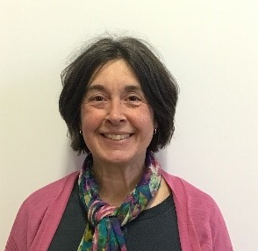
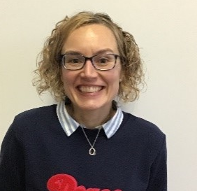
EYFS Teachers
Mrs Johnston
Mrs Hodgson
Notes:
NOTE: To change images on this slide, select a picture and delete it. Then click the Insert Picture icon in the placeholder to insert your own image.

Slide 4
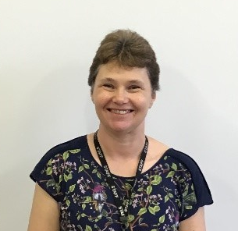
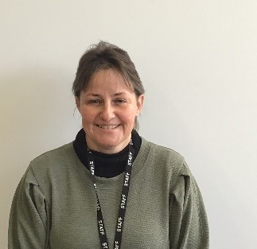
EYFS Support Staff
Mrs Iveson
Mrs Baldwin
Notes:
NOTE: To change images on this slide, select a picture and delete it. Then click the Insert Picture icon in the placeholder to insert your own image.

Slide 5
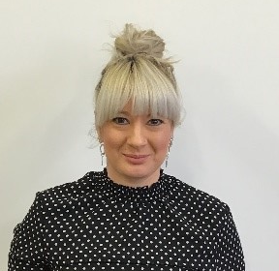
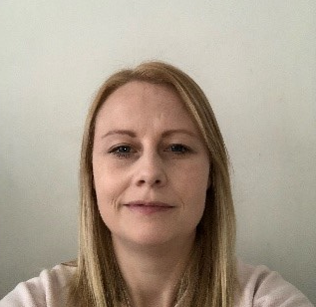
EYFS Support Staff
Mrs Pickard-Sparne
Mrs Walmsley
Notes:
NOTE: To change images on this slide, select a picture and delete it. Then click the Insert Picture icon in the placeholder to insert your own image.

Slide 6
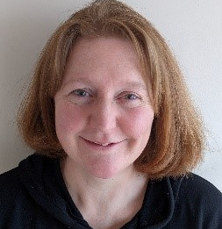
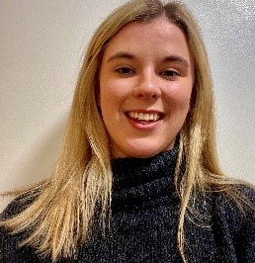
Other members of Staff at Bainbridge
Miss Collins – Base Leader
Miss Atkinson – Owls Teacher
Notes:
NOTE: To change images on this slide, select a picture and delete it. Then click the Insert Picture icon in the placeholder to insert your own image.

Slide 7
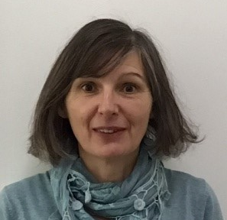
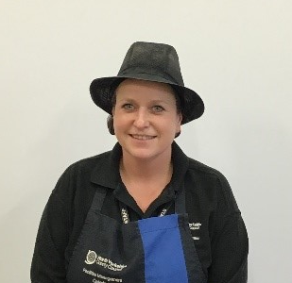
Other members of Staff at Bainbridge
Mrs Fawcett – Owls TA
Mrs Alderson – Cook and MSA
Notes:
NOTE: To change images on this slide, select a picture and delete it. Then click the Insert Picture icon in the placeholder to insert your own image.

Slide 8
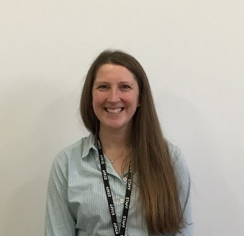
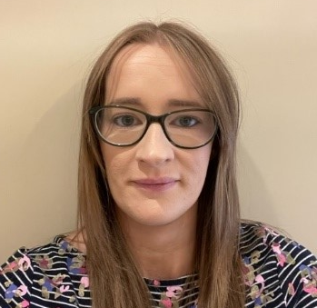
Office Team
Mrs Gurden
Mrs Teasdale
Notes:
NOTE: To change images on this slide, select a picture and delete it. Then click the Insert Picture icon in the placeholder to insert your own image.

Slide 9
Evidence Me
Our home-school communication app

Slide 10

Home-school communication app
Notes:
NOTE: To change images on this slide, select a picture and delete it. Then click the Insert Picture icon in the placeholder to insert your own image.

Slide 11
What you can expect from us…
Regular (weekly) notifications with pictures and a short summary of what your child has been doing:
  something they have done for the first time
  something they are persevering with
  a special or significant moment
We do not expect a reply to each notification, but we will read your responses if you send them, and reply to you.

Slide 12
What you might like to share with us…
Pictures of your child doing something new for the first time
Pictures of your child practising something they have been learning at school
Pictures of you enjoying something special, significant, or important at home
We love looking at things you have shared with us and we endeavour to reply.

Slide 13
Getting started
Download the app
Follow instructions sent by school
Trouble-shooting

Slide 14
Early Reading
Phonics and early reading

Slide 15
Systematic Synthetic Phonics Programme
What is synthetic phonics?
Validated list
Learning to read and reading to learn
  Phonics as part of a rich reading environment

Slide 16
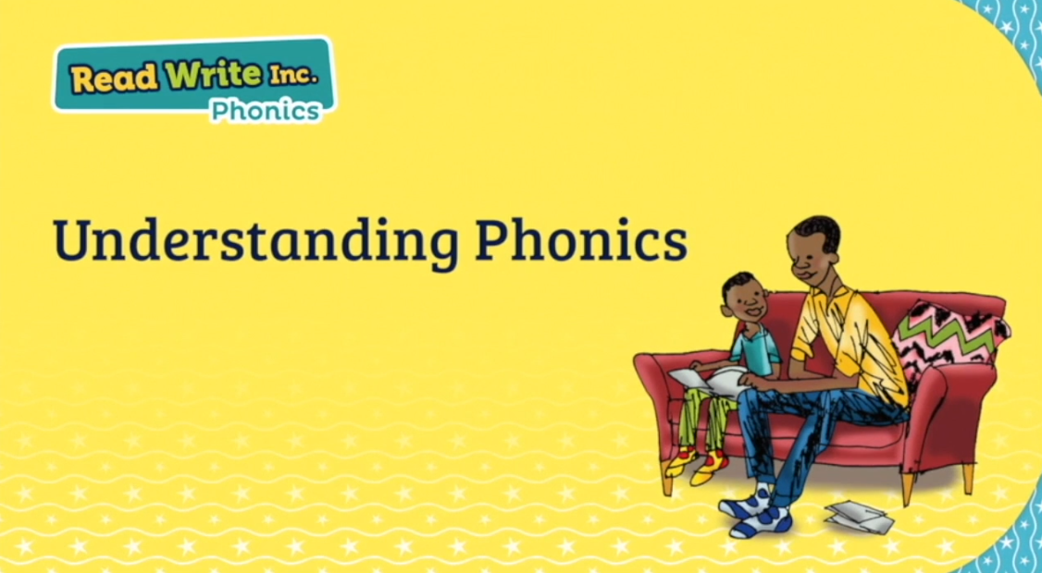

Slide 17

Our phonics scheme
Notes:
NOTE: To change images on this slide, select a picture and delete it. Then click the Insert Picture icon in the placeholder to insert your own image.

Slide 18

Getting started with Read, Write, Inc…

Slide 19
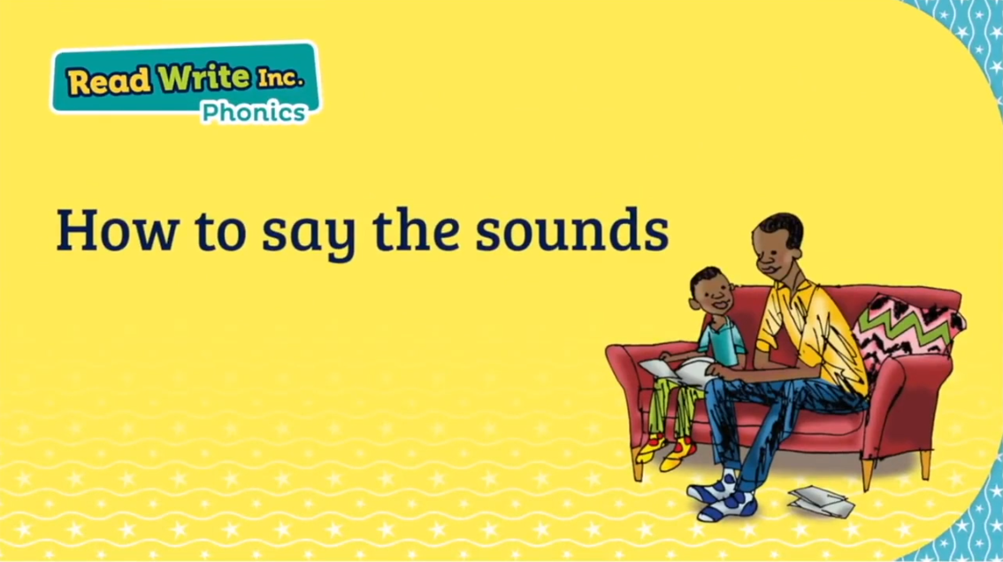

Slide 20
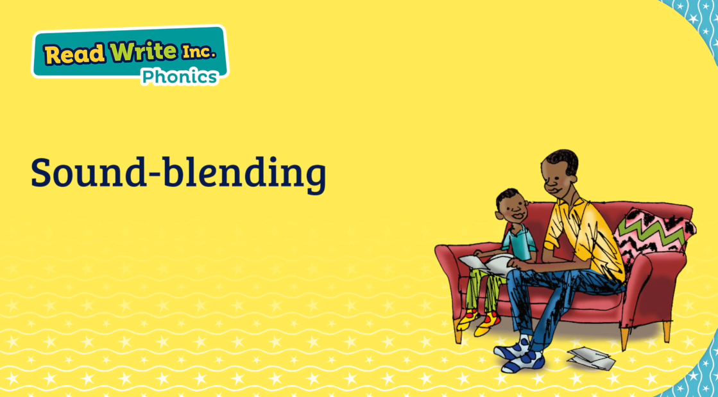

Slide 21
The Phonics Screening Check

Slide 22
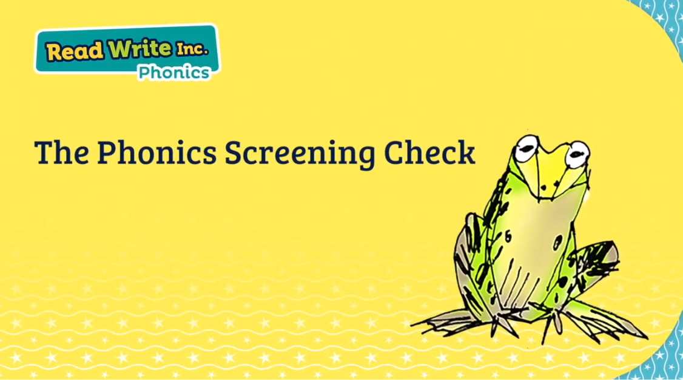

Slide 23
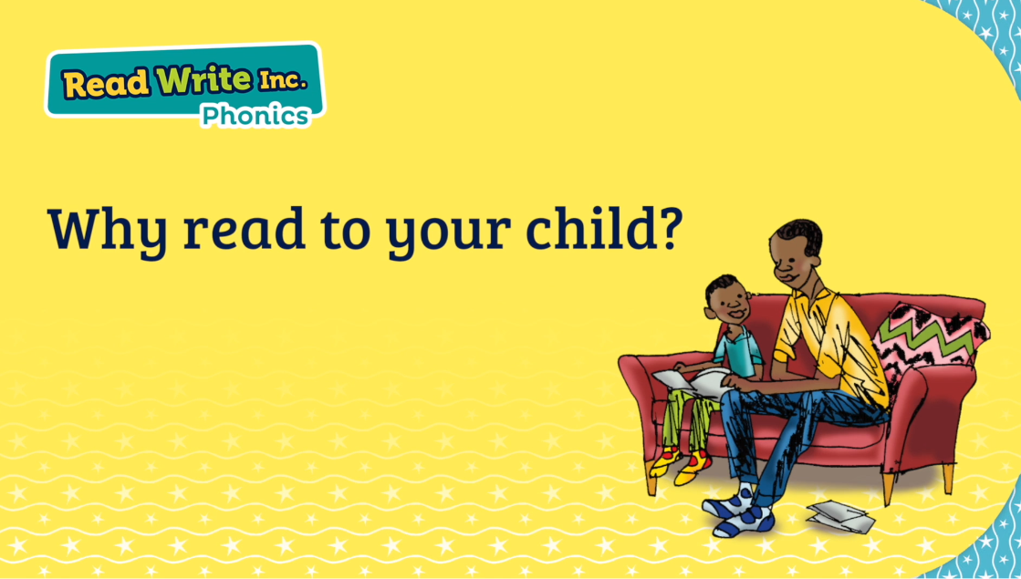
How does a systematic phonics programme sit within a wider rich, reading environment?

Slide 24
How does a systematic phonics programme sit within a wider rich, reading environment?
What we also provide at school:
Library
Talk through stories
Daily stories
Non-fiction books linked to current learning
Poetry
Online stories
Audio books

Slide 25
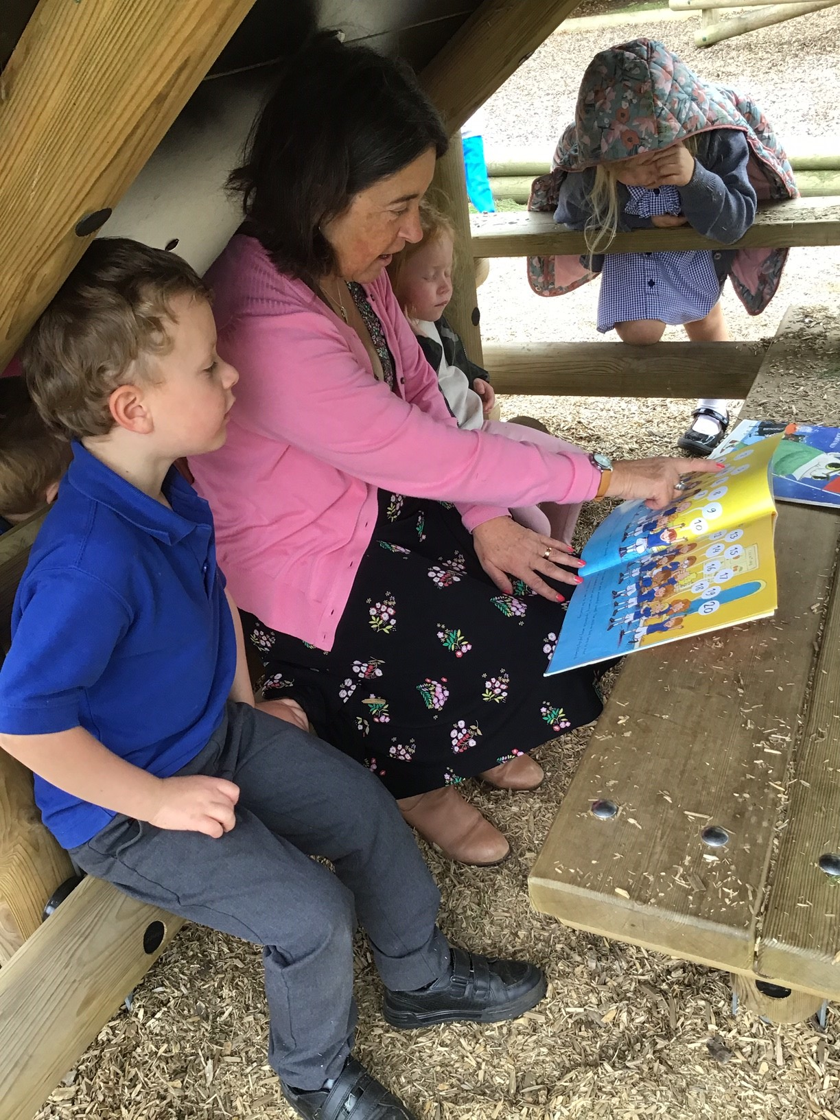
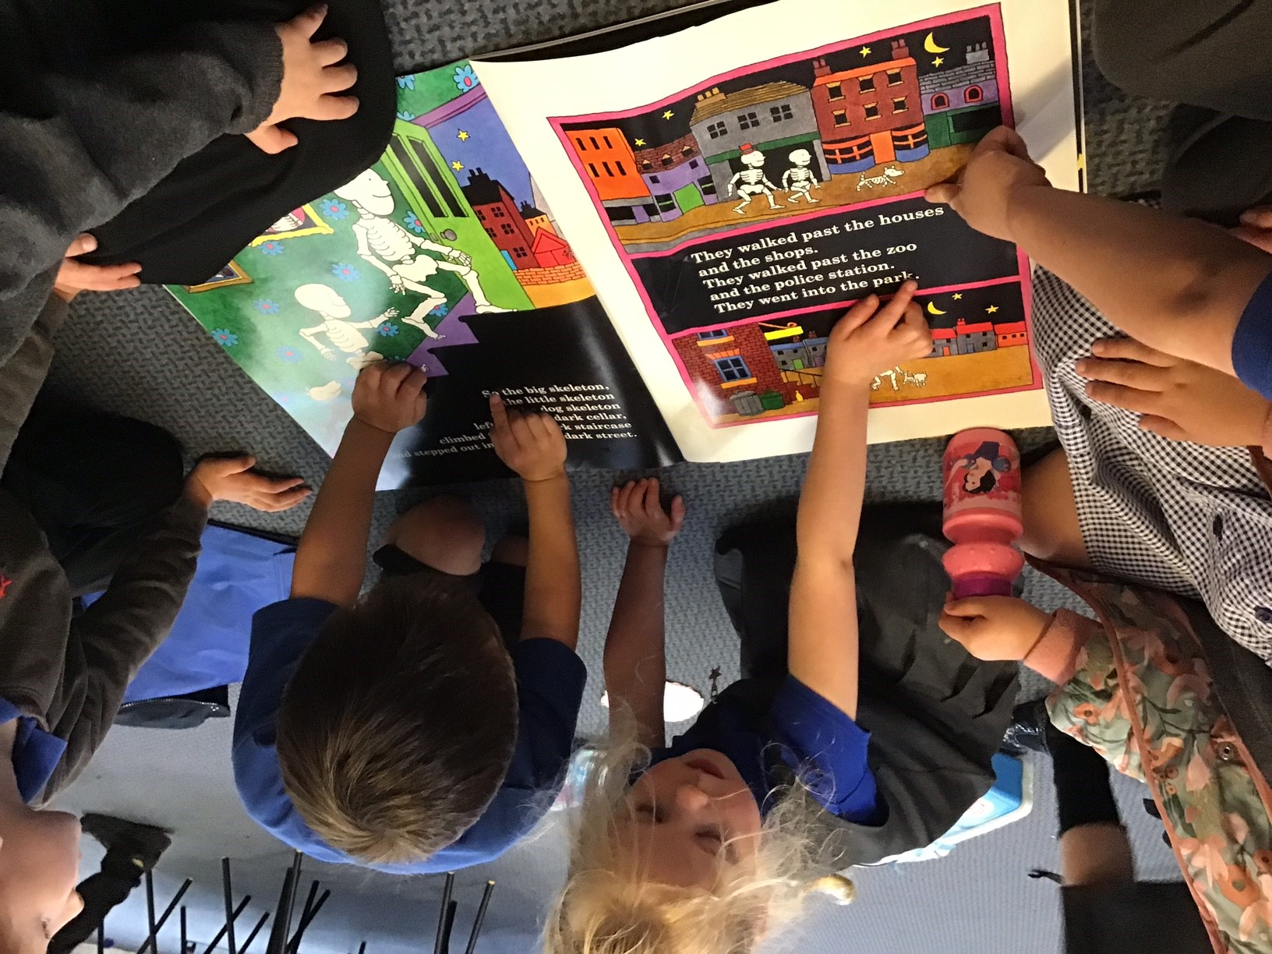
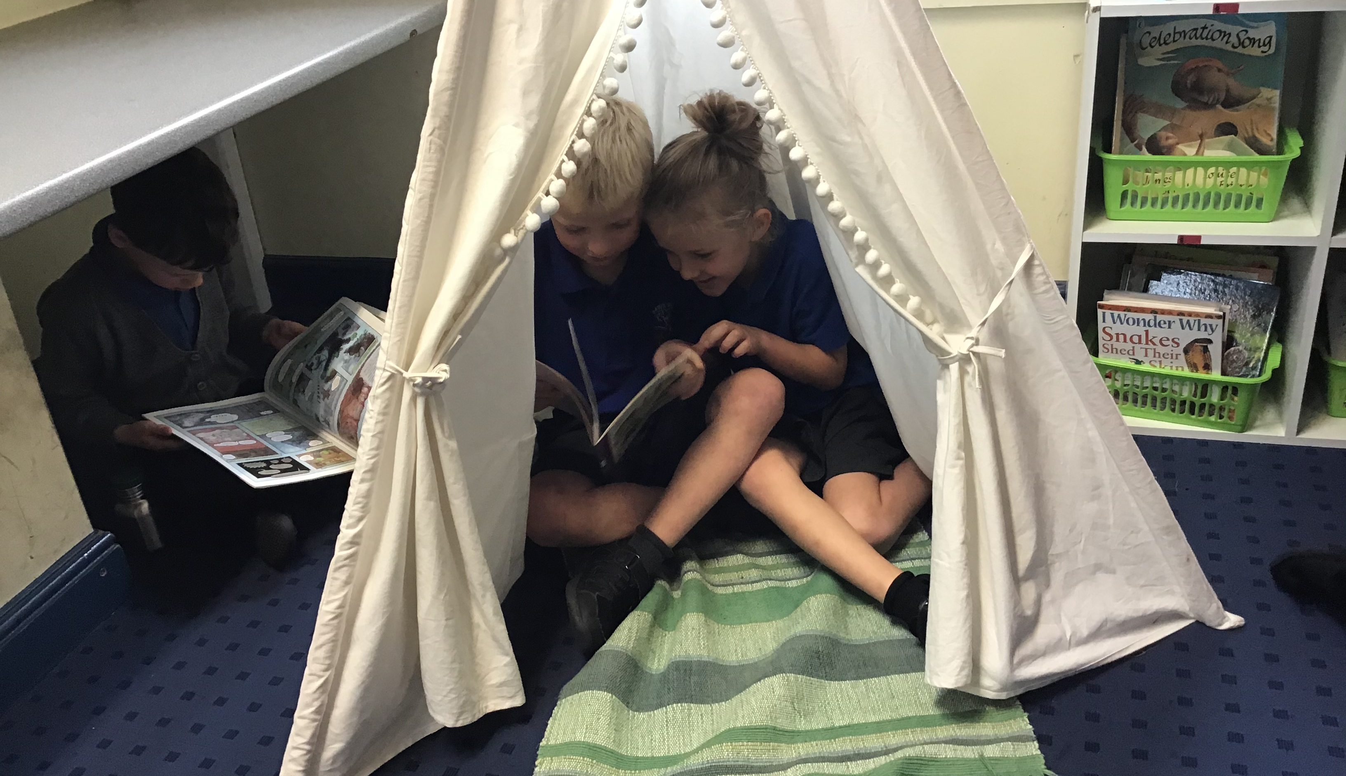
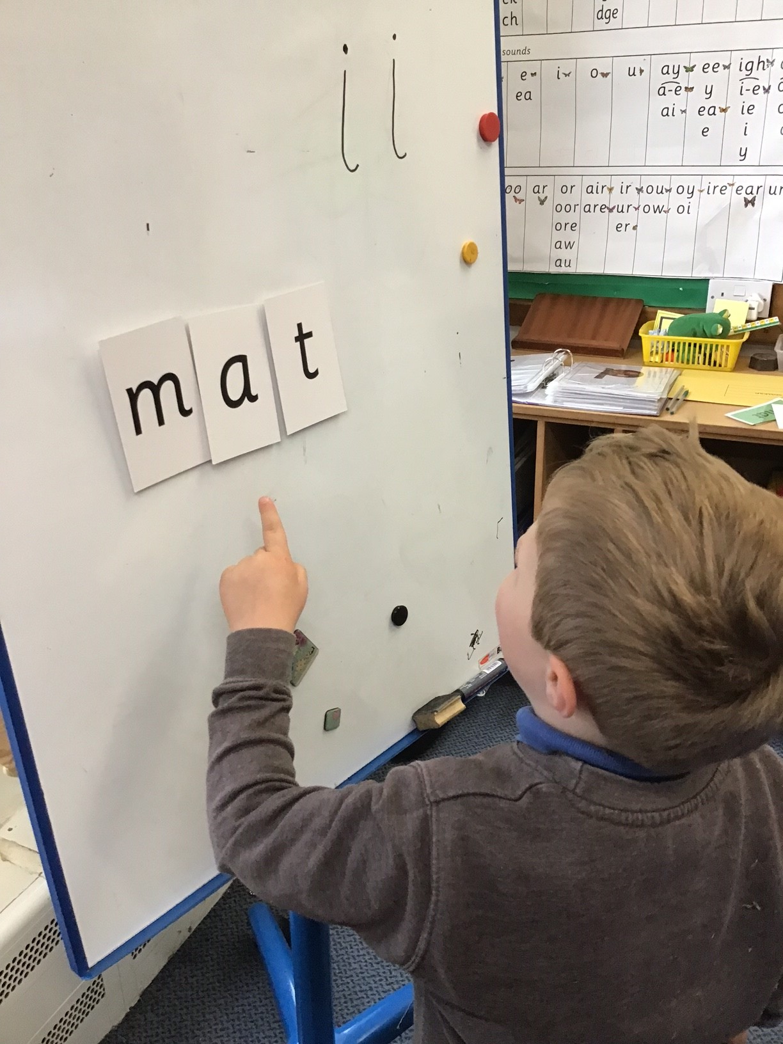
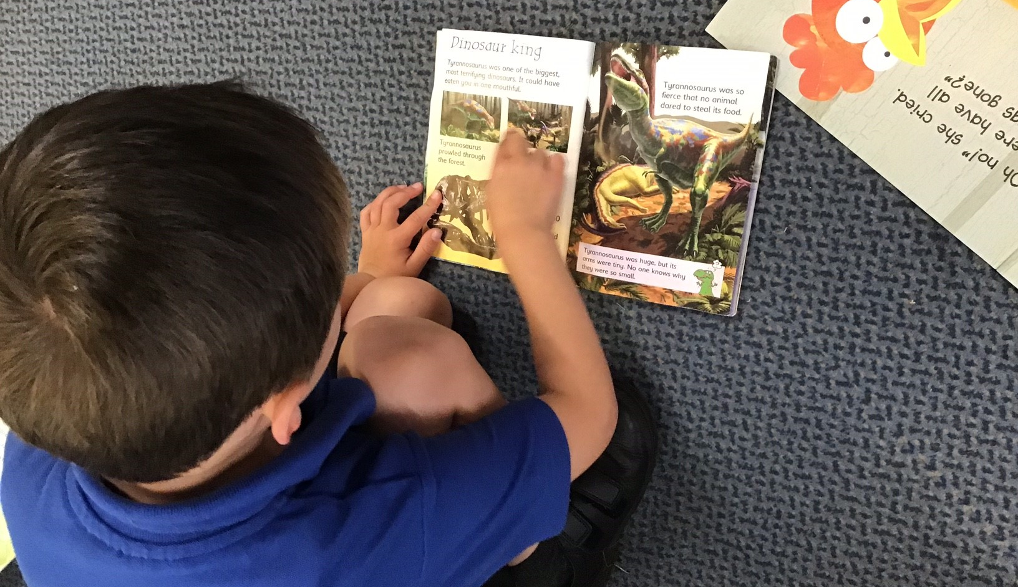
We foster a love for reading.
We value reading.
We know that reading unlocks learning.
Notes:
NOTE: To change images on this slide, select a picture and delete it. Then click the Insert Picture icon in the placeholder to insert your own image.

Slide 26
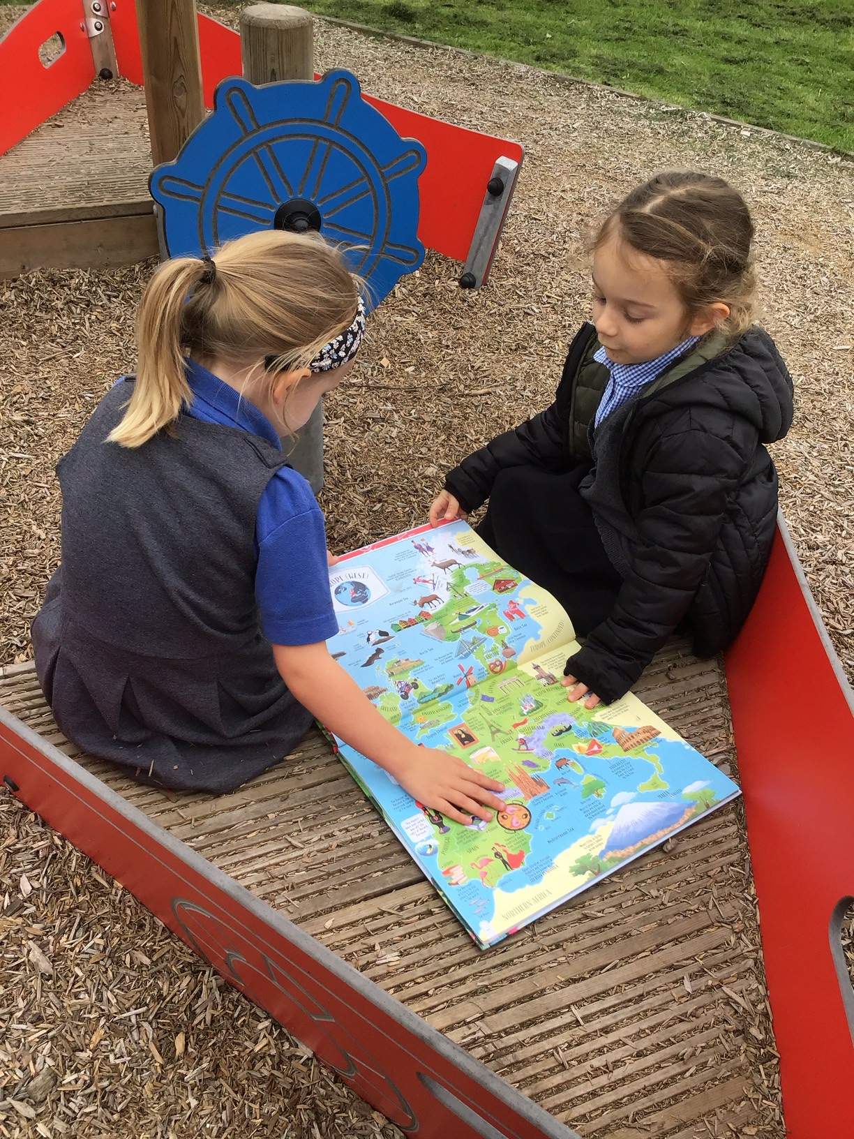
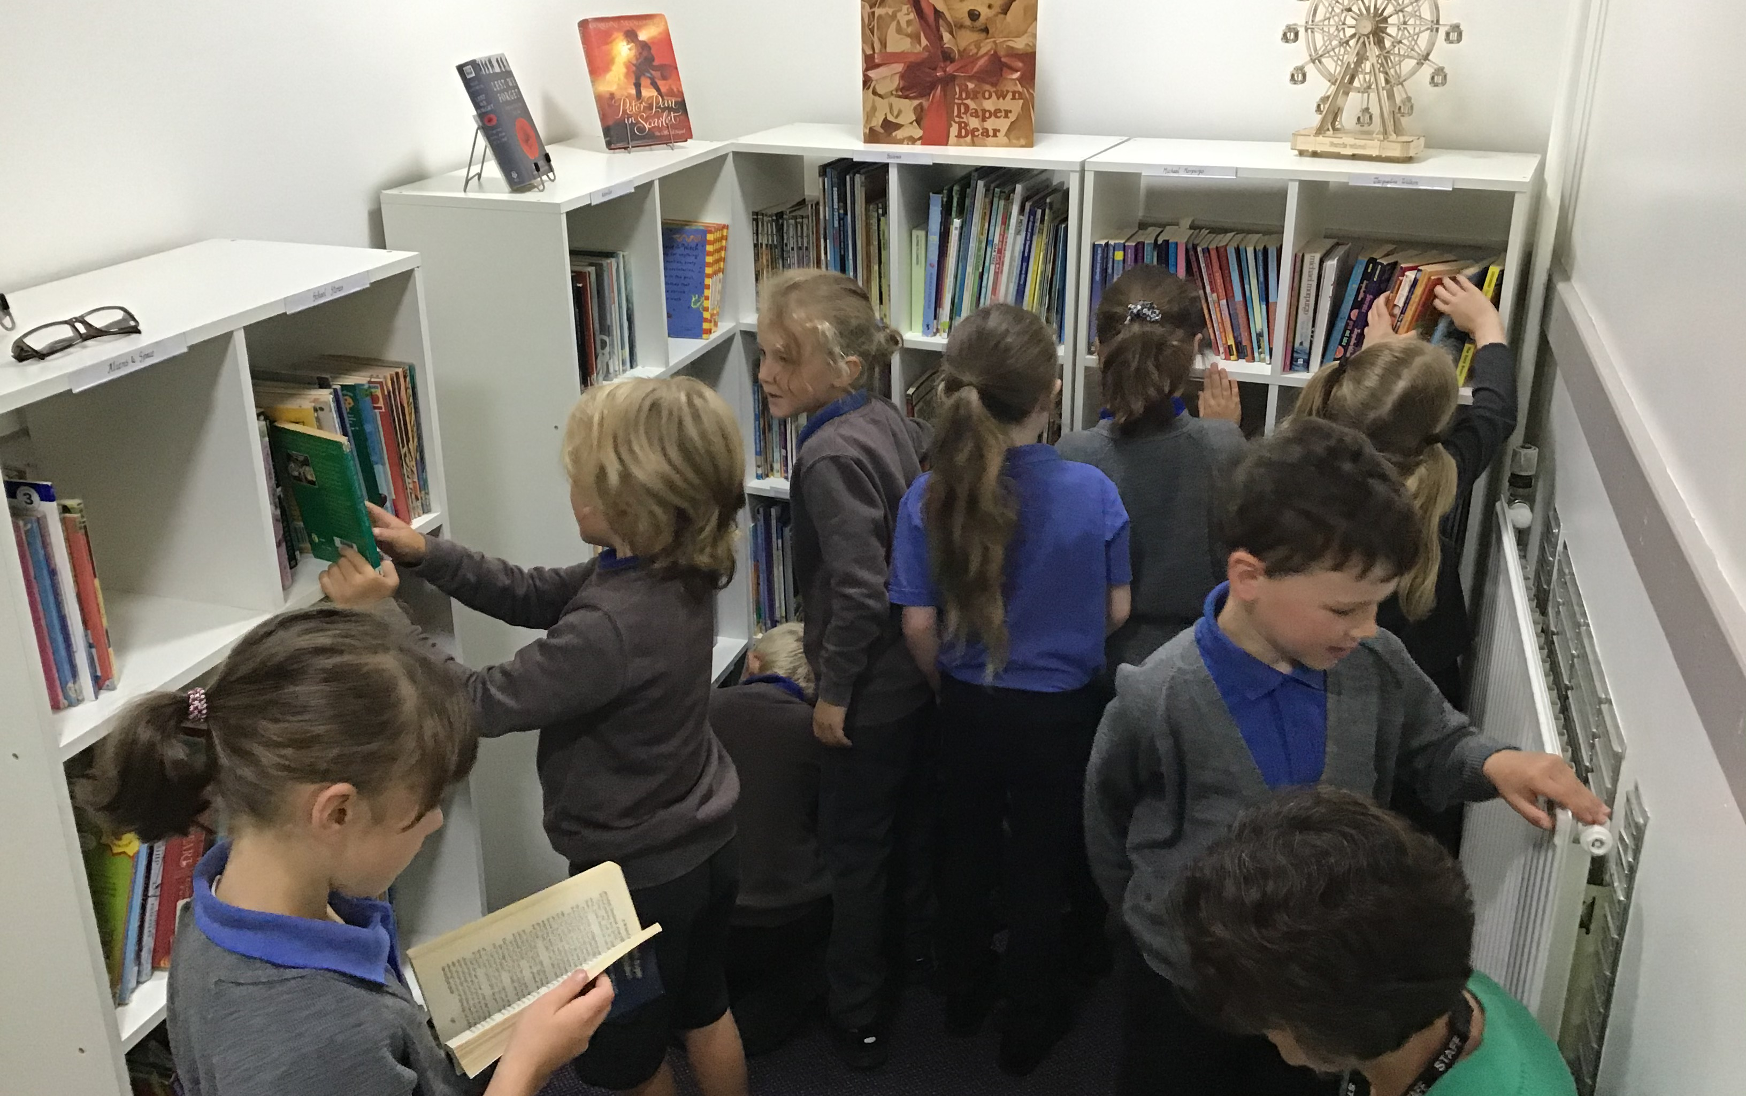
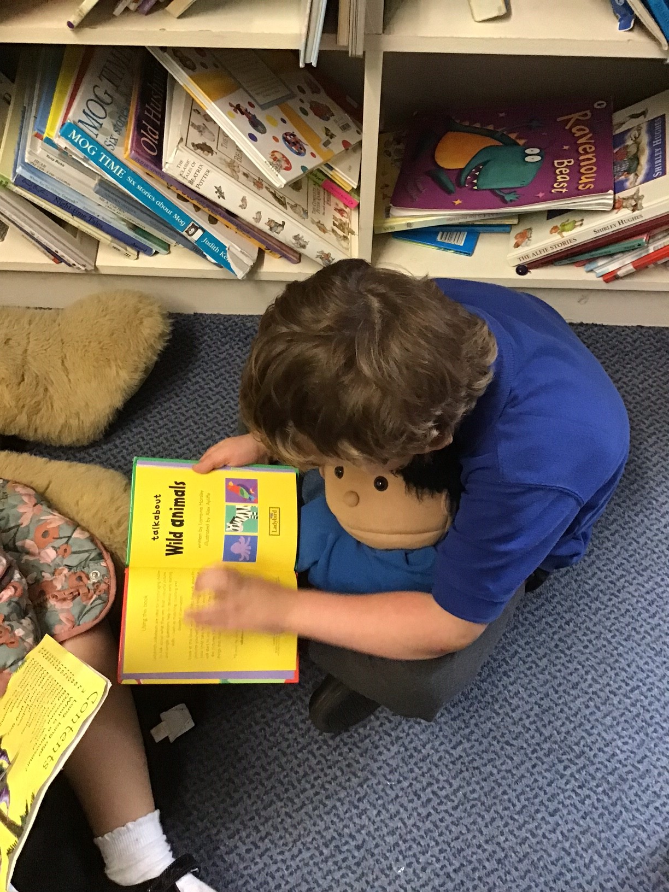
Notes:
NOTE: To change images on this slide, select a picture and delete it. Then click the Insert Picture icon in the placeholder to insert your own image.

Slide 27
